Slide 1
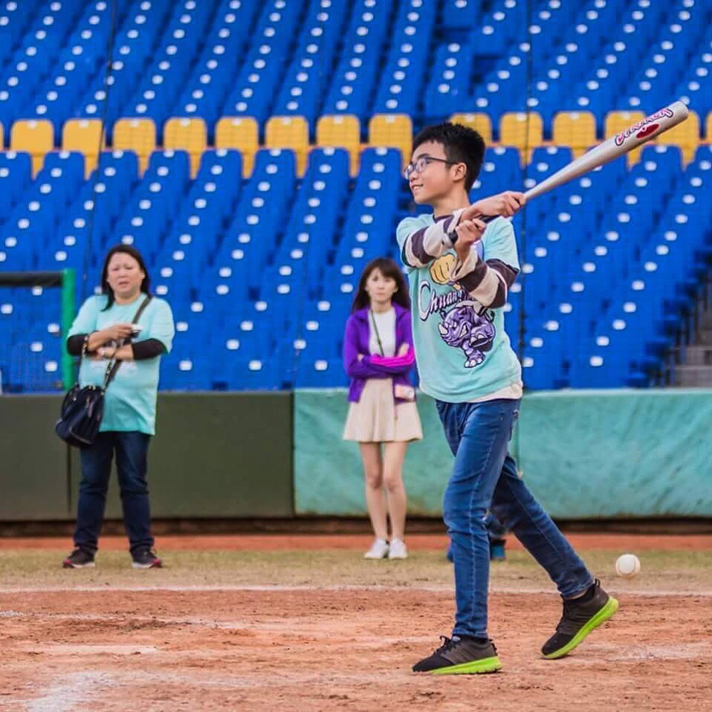
Profile Pic
HenryWasTaken
Place Picture Here
Place Picture Here
Pewdiepie, Markiplier and 15 others
I look so happy but I’m so tired!!! #sport #baseball.

