Slide 1
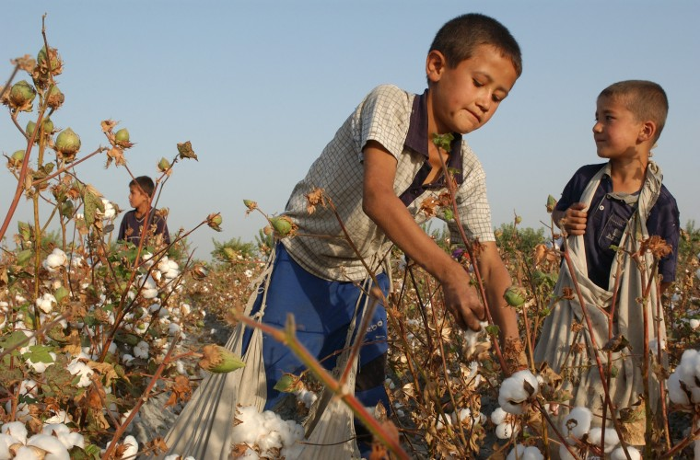
Modern VS Industrial revolution
COTTON

Slide 2
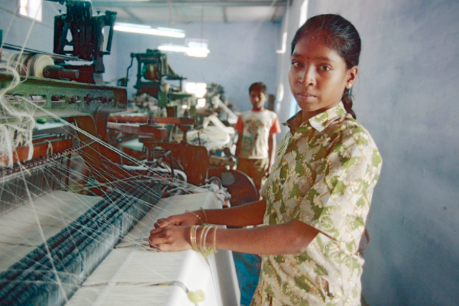
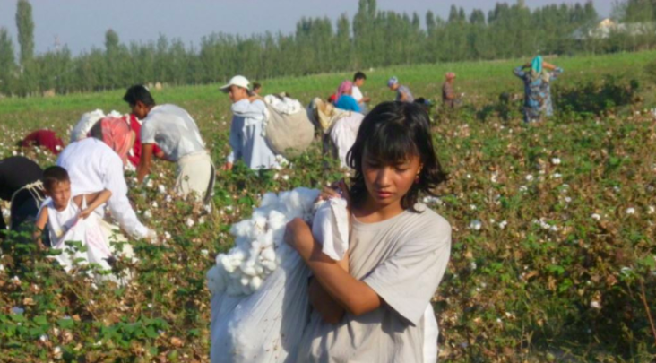
Child Labor of Cotton. (Present)
Children from the ages 11 -15 are forced by the Government to work. Estimated about 170 million children around the world are forced into child labor.
Children are exposed to harmful pesticides and herbicides at their working environment for at least 8-12 hours a day.

Slide 3
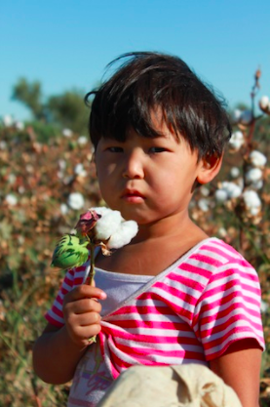
Present
Worker’s maximum wage per day is less than 1 dollar despite of supporting ¼ of their families.
The main producers of cotton are Uzbekistan, Egypt, Pakistan, China, India, America, Turkey and Brazil.
The World Bank is funding child labor in Uzbekistan.
Workers have to carry 75-100 kg of cotton and load them onto trucks.

Slide 4
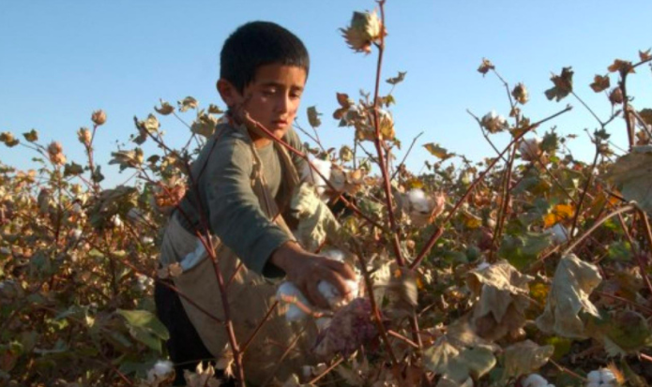
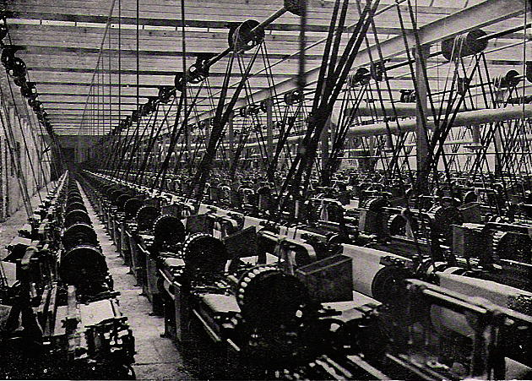
Similarity then and now
-Both are either paid less or not paid at all
-Targeted at poor people/children
-Working in dangerous conditions, can lead to injury or even death.
-Laws that protect children are neglected or hidden by the government and factory/mill owners.
- No medical care provided

Slide 5
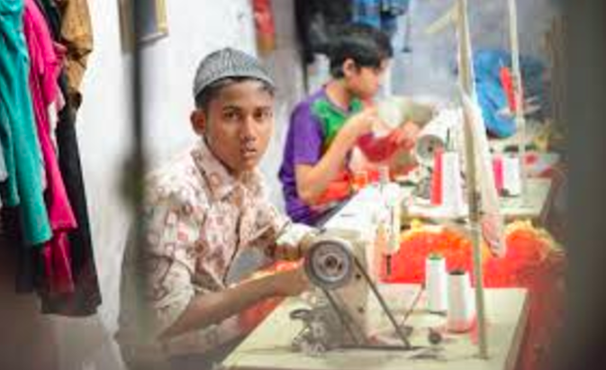
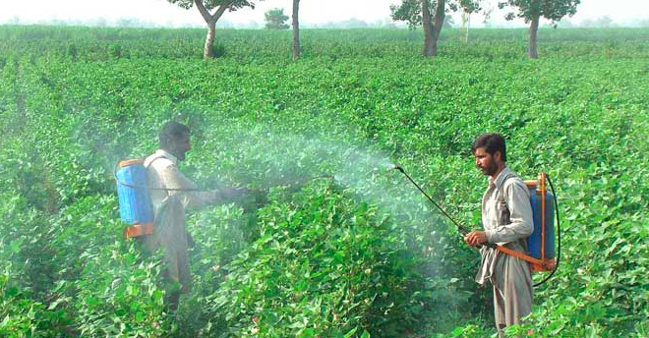
Differences
Children are exposed to harmful pesticides and herbicides.
There are big organizations standing up against child labor in the cotton industry.
Children today are force by the government to do labor work they have no options.

