Slide 1
Personal Learning Goal
FEA
Reading
By Henry

Slide 2
My Goal
My goal is to learn grammar and learn more advance vocabulary through reading a book

Slide 3
In depth about my goal
My teacher and I felt that reading books also benefit me for learning new vocabs and grammar so we decide to do both
I chose my goal because I want to improve my reading and grammar in the same time

Slide 4
The Book
The book that I read is called 13 reasons why by Jay Asher
This book is about a girl called Hannah Baker who ended her life due to bullying, she recorded 13 tapes explaining the 13 reasons why she did it
This book is now a Netflix original series
The reasons why I read about this book is because I really like how the author put issues from the society into a book and make it sound interesting and realistic.

Slide 5
Time Management:
I manage a time table so when I do work it will be more efficient and manageable
Time table
Section 2 Title
Read 1 chapter each week
5 vocab each week
1 reflection each week
Half a chapter each week
5 vocab each week
3 reflection 2 week before due date

Slide 6
Enviroment
I like to study in my room with music and scented candle or in a café. I don’t really have preference but if I have to choose then I will choose my room.

Slide 7
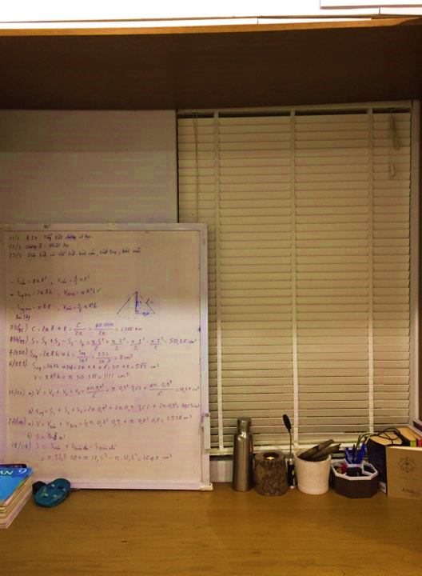
My Room

Slide 8
Learning experience
I’ve learn plenty skills, I learned how to identify a foreshadow, learn now advance vocab and summarizing skill.

Slide 9
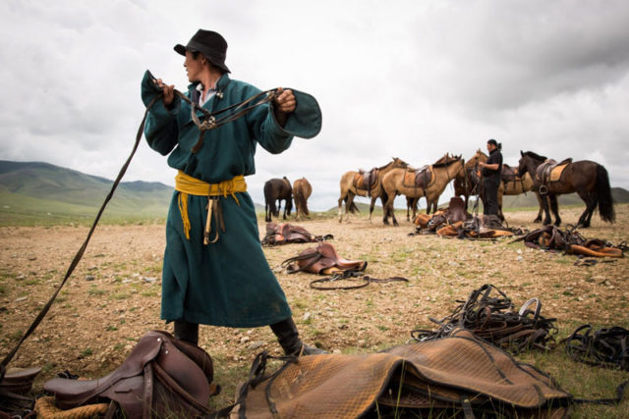
Example of my skills
I will now show you one of the skills that I learned is to find new vocabs
Mirage . Alibi . Nomad

Slide 10
Overall Experience (reflection and tips)
Overall I feel like I did a pretty good job. I learned many skills. I did successfully acquired my goal. I would improve/ be better if I do the work according to the time table to be more time efficient
TIPS:
+Pick your favourite book to read to make you focus more
+Make a time table that really fits your work hour

Slide 11
THANK YOU! Any questions?

